Slide 1
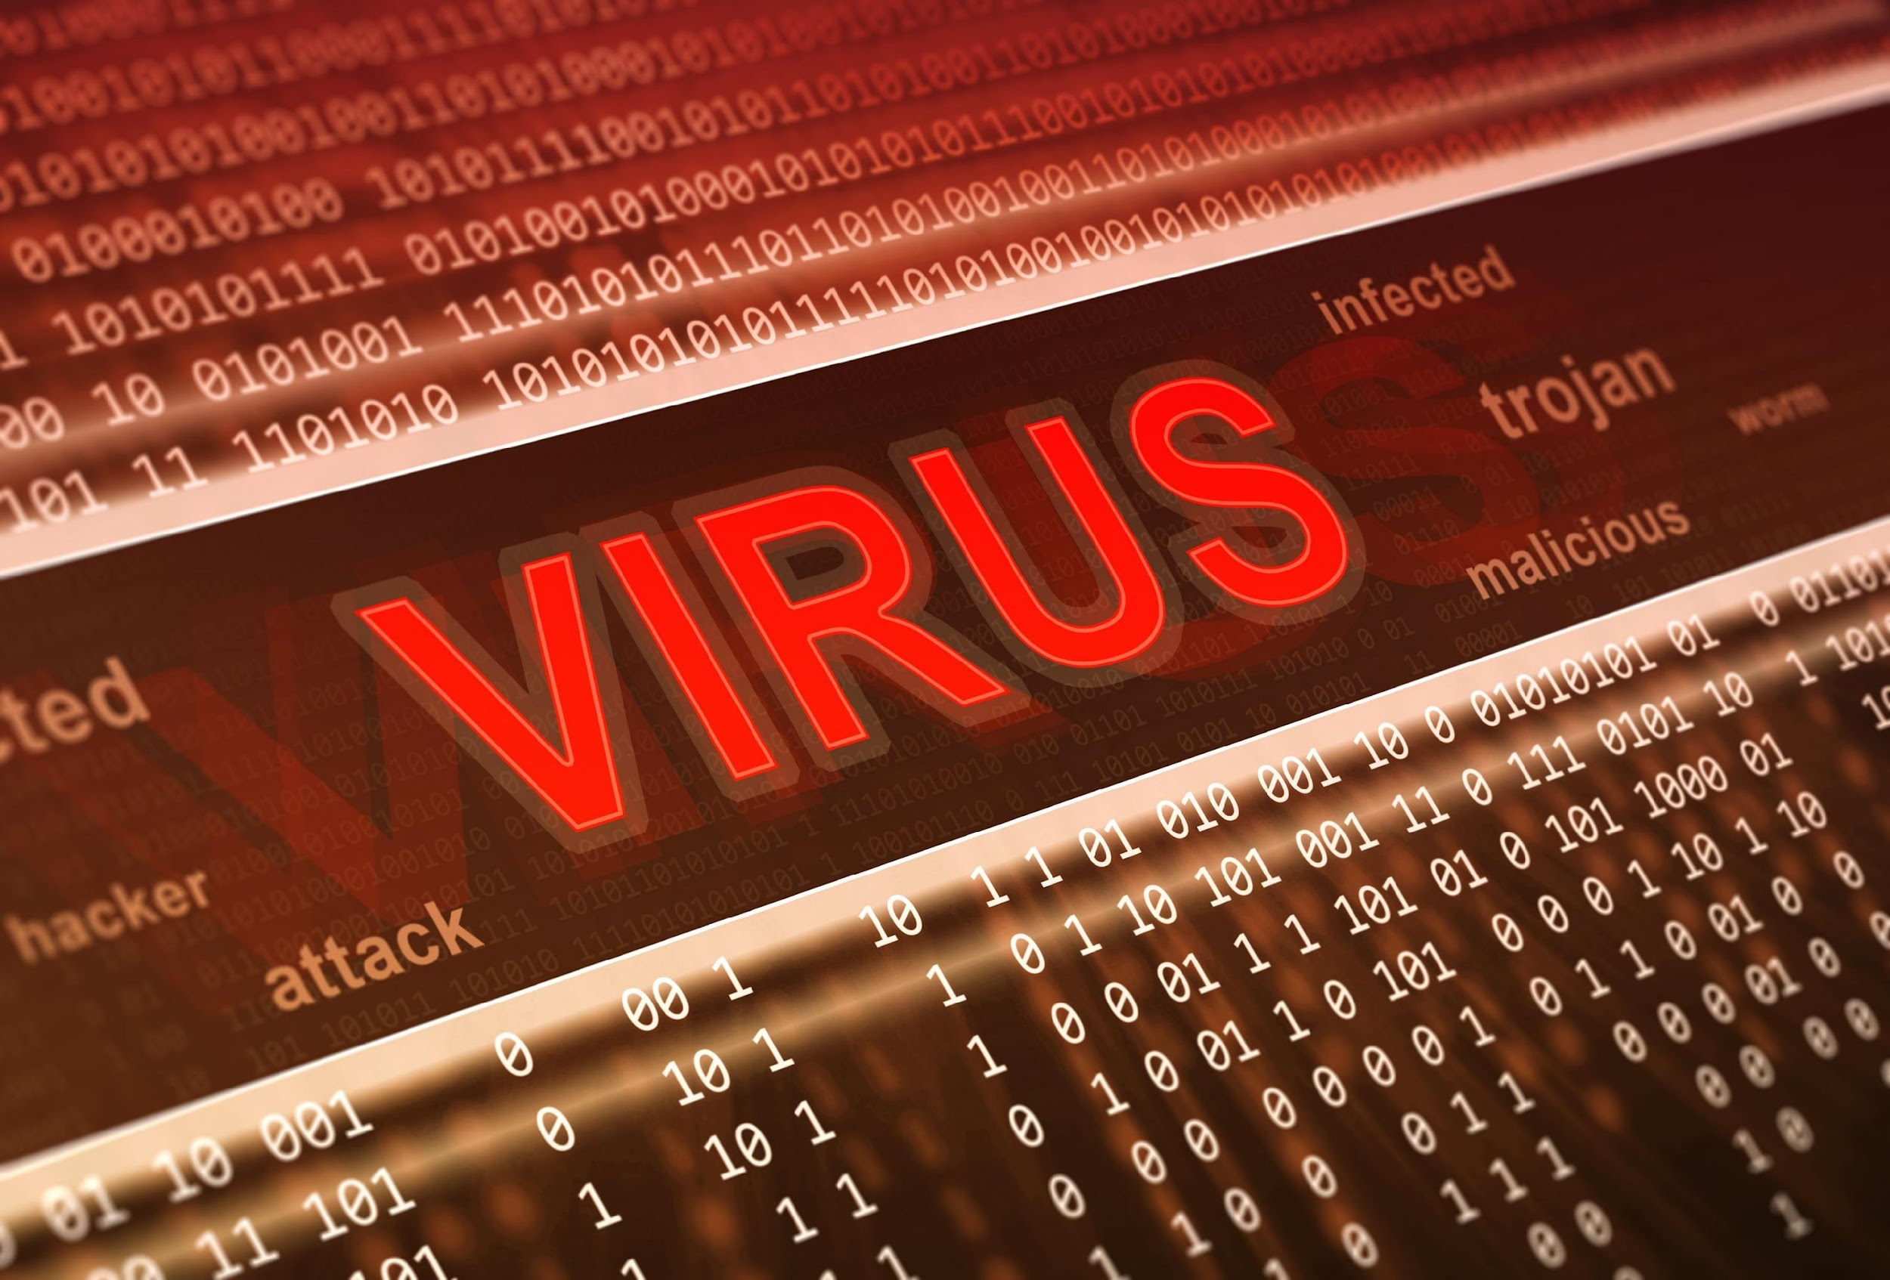
ROOTKITS

Slide 2
Rootkits
“The burglar hiding in the attic”.
Hardest malware of all to detect and remove.
It allows viruses and other malware to “hide in plain sight” by disguising them as real essential files.
Can bypass encryption and evade anti-malware programs
Run when the system starts to boot
Recommended solution will be to wipe out the hard drive.

Slide 3
1
Kernel Level - They have the highest privilege and can inject code in the core of the OS.
2
Application Level - Can modify the behaviour of existing applications
ROOTKITS
3
Library Level - Can hook, patch or replace system calls with malicious code to hide its presence
Hypervisor Level - They target the boot sequence and load themselves as an hypervisor
4
5
Firmware Level - Overwrite the BIOS of the PC. Allows the rootkit to install and hide malware

Slide 4
Symptoms
Antimalware doesn’t work anymore
Windows settings change e.g pinned items changing, background images
Frozen input devices like mouse and keyboard
High network usage on idle computer

Slide 5
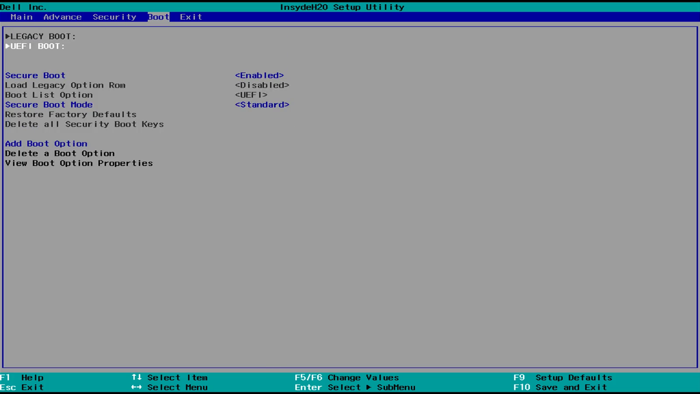

Slide 6
Rogue Security Software
Pretends to be a good program to remove malware but is in fact a malware itself.
Very often will turn off any real security software available.
Gotten from websites offering better security.
Only install security software from known vendors.

Slide 7
Worst Ransomware
WannaCry - May 2017
Infected over 200,000 computers in 150 countries. Used a vulnerability in Windows operating system.
TorrentLocker - Early 2014
Encrypted files and relied on spam emails for distribution. Used geographical targeting.
Ransomware
Locky - February 2016
Extorted $17,000 from a hospital in Hollywood. Continues to spread across the world.
CTB Locker - Early 2014
Includes multilingual capabilities and is one of the first ransomware to be sold as a service in underground forums.

Slide 8
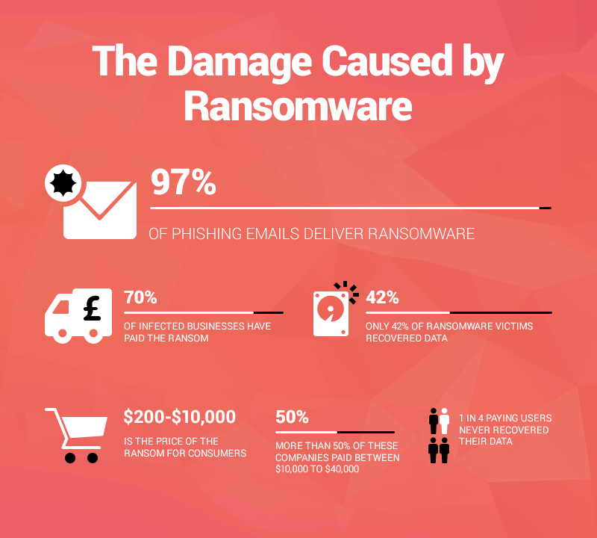

Slide 9
Fight Against Trojans
Using anti-malware products.
Run updates when available.
Download files from only trusted websites.

Slide 10
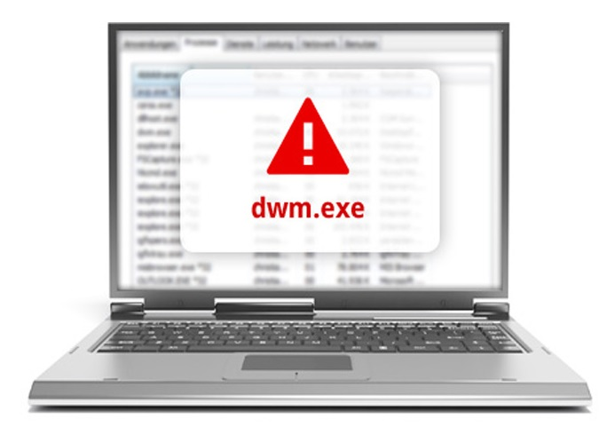
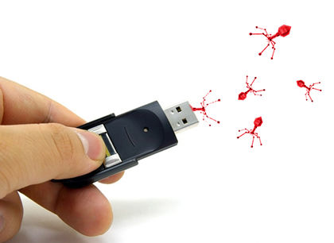

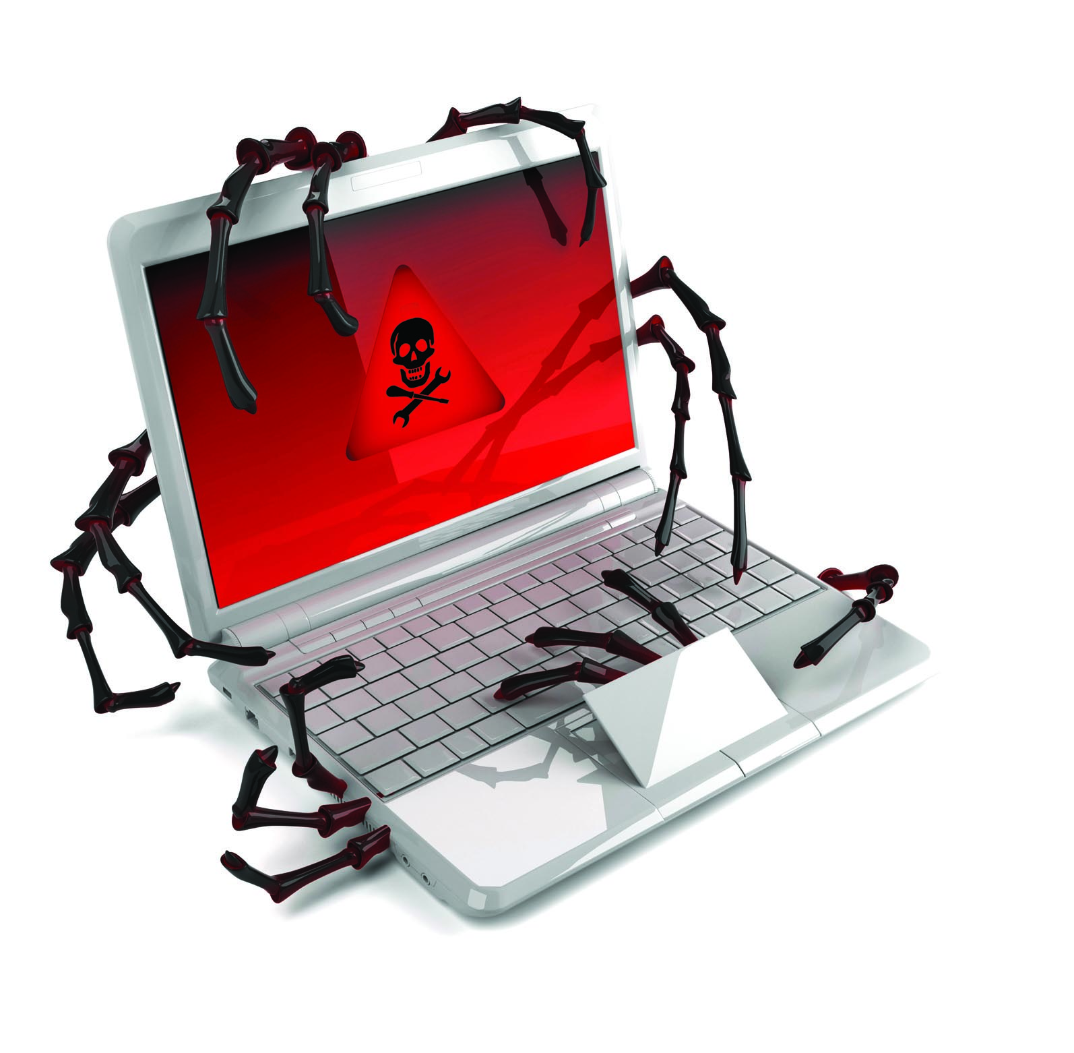
VIRUSES
1
2
3
4
Viruses typically attach themselves to executable files and Word documents.
They spread via email attachments, infected websites and flash drives.
A virus will remain dormant until the infected file or system is activated.
Once activated, the virus causes destruction.

Slide 11

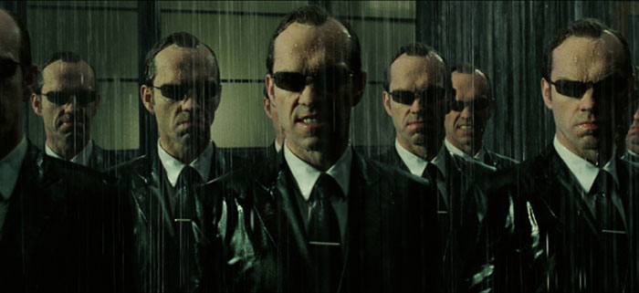
WORMS
1
2
Worms enter systems via network connection or a downloaded file.
They then make copies of themselves and can spread via a network / internet connection.

Slide 12
Viruses & Worms
Viruses can vary widely in their objectives
Some are purely destructive i.e destroy files
Others can slow down system performance
Some viruses are non destructive i.e latent viruses

Slide 13
Fight Against Viruses & Worms
Antivirus and Antimalware products
Restrict use of flash drives
Scan Email Attachments

